Slide 1
Platform analysis
Ting Sit
1/4/2020

Slide 2
Objective
Provide recommendations to our operating system client on whether they should choose to build apps within Google Play or Apple Store
Client would favor platform that has higher review ratings

Slide 3
Model considerations
Descriptive analysis, using historical reviews data as found on Kaggle for Google and Apple
Apply hypothesis testing combine with permutation, access the significance of difference on average review ratings among the two platforms

Slide 4
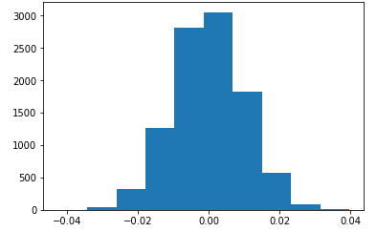
Results
Null Hypothesis – no difference in mean reviews among the two platforms
Observed mean difference in the dataset : 0.142
Permutation mean difference : 0.02
Range of difference with 10,000 time permutation: [-0.03 : +0.03]

Slide 5
conclusion
The observed difference in mean reviews fall outside the range of permutation
The observed difference is significant
The platform rating is different among platforms, with Google Play having a 0.142 higher average review rating than Apply Store

Slide 6
Next step
Repeat the analysis by narrowing down ‘category’ or ‘genre’ to capture user ratings that relate closer to client’s apps
Rebalance Google and Apple dataset to have similar number of records
Google dataset has more rows than Apple.
Ratings tend to skew toward 4 stars or above, more rows could naturally drive up average ratings
Analysis only cover US data. If client decide to launch apps in different countries, the analysis will need to be re-run with bigger dataset

